Slide 1
ROMANS 8:16-28
PRESENT SUFFERING
FUTURE GLORY

Slide 2
V18- I “consider”- not a theoretical assumption, but experiential knowledge
Our present suffering is not comparable to our future glory.
(We need the right perspective)
2 Corinthians 11:25-30 Paul’s suffering

Slide 3
2 Corinthians 11:25-30
Beaten with rods 3 times
Shipwrecked 3 times
Dangers from: stoning, river, robbers, Gentiles, Jews, cities, wilderness, sea, false Christians,
Hardships, labor, sleepless nights, hunger, thirst, cold, exposure, etc…

Slide 4
Colossians 3:2
Set your mind on things above, not on things on the earth.
Philippians 3:20
For our citizenship is in heaven, from which we also eagerly wait for the Savior, the Lord Jesus Christ.

Slide 5
V19 Creation is subjected to decay
The remedy is the glory to be revealed
V20- Creation is subject to “futility”
(emptiness, pointless, useless)
Ecclesiastes 1:2 “Vanity of vanities,” says the Preacher;
“Vanity of vanities, all is vanity”

Slide 6
Any Mental Illness (AMI): In 2024, an estimated 61.5 million U.S. adults (23.4%) experienced a diagnosable mental illness in the past year
Serious Mental Illness (SMI): About 14.6 million adults (5.6%) had a condition causing serious functional impairment
Depression: Major depressive episodes affect about 8.2% of U.S. adults
APA Magazine- “Undertreatment in mental health” (take more meds)

Slide 7
Ecclesiastes 12:13 Let us hear the conclusion of the whole matter: Fear God and keep His commands for this is the whole duty of mankind.
Micah 6:8 He hath shown thee, O man, what is good: and what doth the Lord require of you but to do justly and to love mercy, and to walk humbly with your God.

Slide 8
V21-22 Every area of creation touched by sin will be touched by God’s glory
V23-24 We wait in hope for the Lord’s return to set all things right.
V24-25 Our hope (blessed assurance) will one day be sight.
V20- Futility was left with hope

Slide 9
Last word in Malachi- curse
First person listed in Matthew- Jesus
1 Peter 1:3 Praise be to the God and Father of our Lord Jesus Christ! In his great mercy He has given us new birth into a living hope through the resurrection of Jesus Christ from the dead.

Slide 10
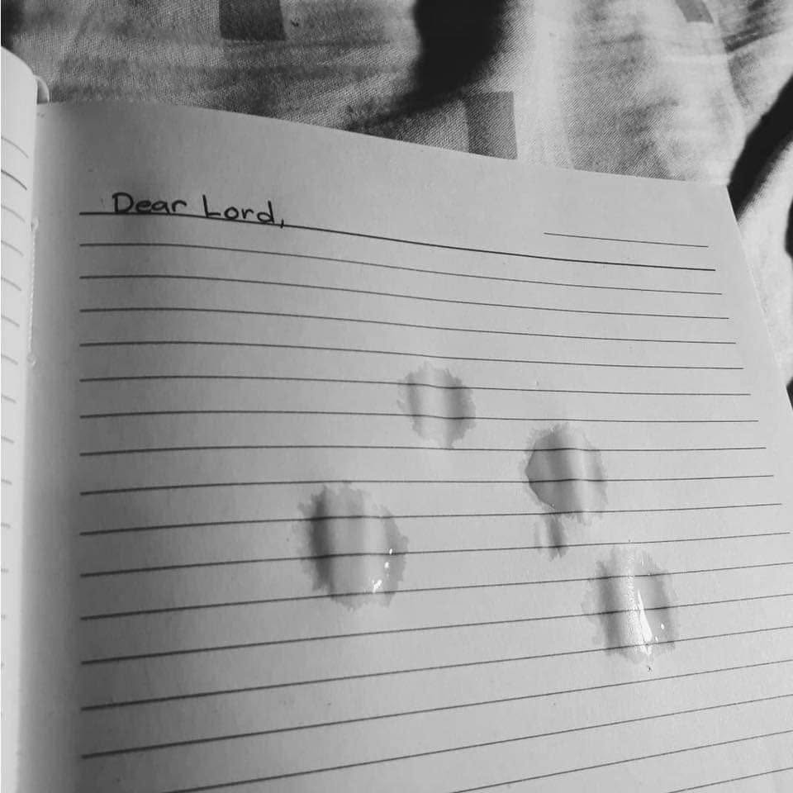

Slide 11
V28- Called according to His purpose
The call to:
Salvation- John 1:39 Come and see
Sanctification- Matt 4:19 Follow Me
Service- John 14:12 Do My work
Suffering- Matt 16:24 Deny self
Glory- Matt 25:23 Well done, good and faithful servant

